Slide 1




Let’s Build a Psychologically Safe Team – Together!

Slide 2
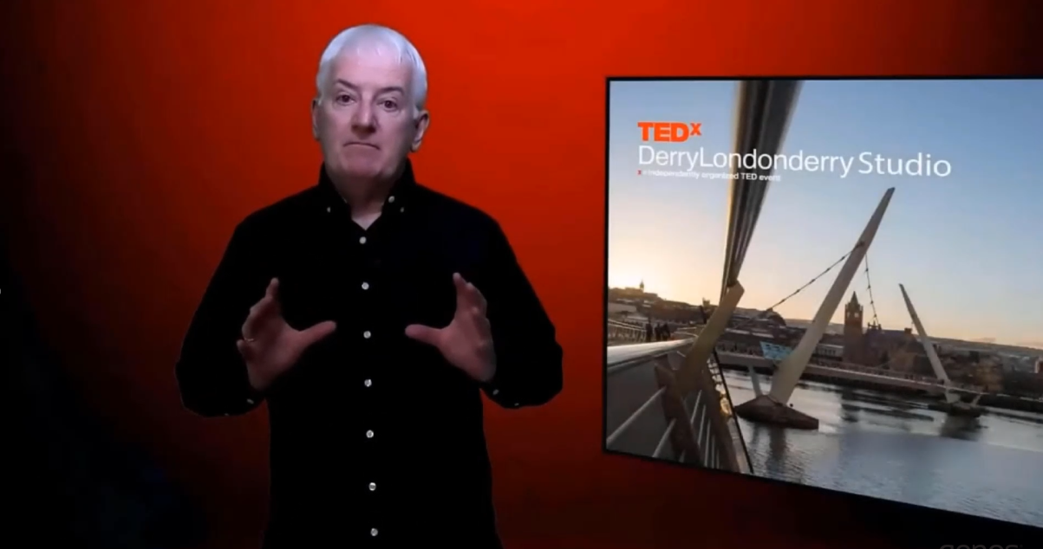



Slide 3
If you’ve had any of those experiences then you
know what it’s like to feel ‘psychologically unsafe’
- and it’s not pleasant, right?

Slide 4

Trust vs. Psychological Safety

Slide 5
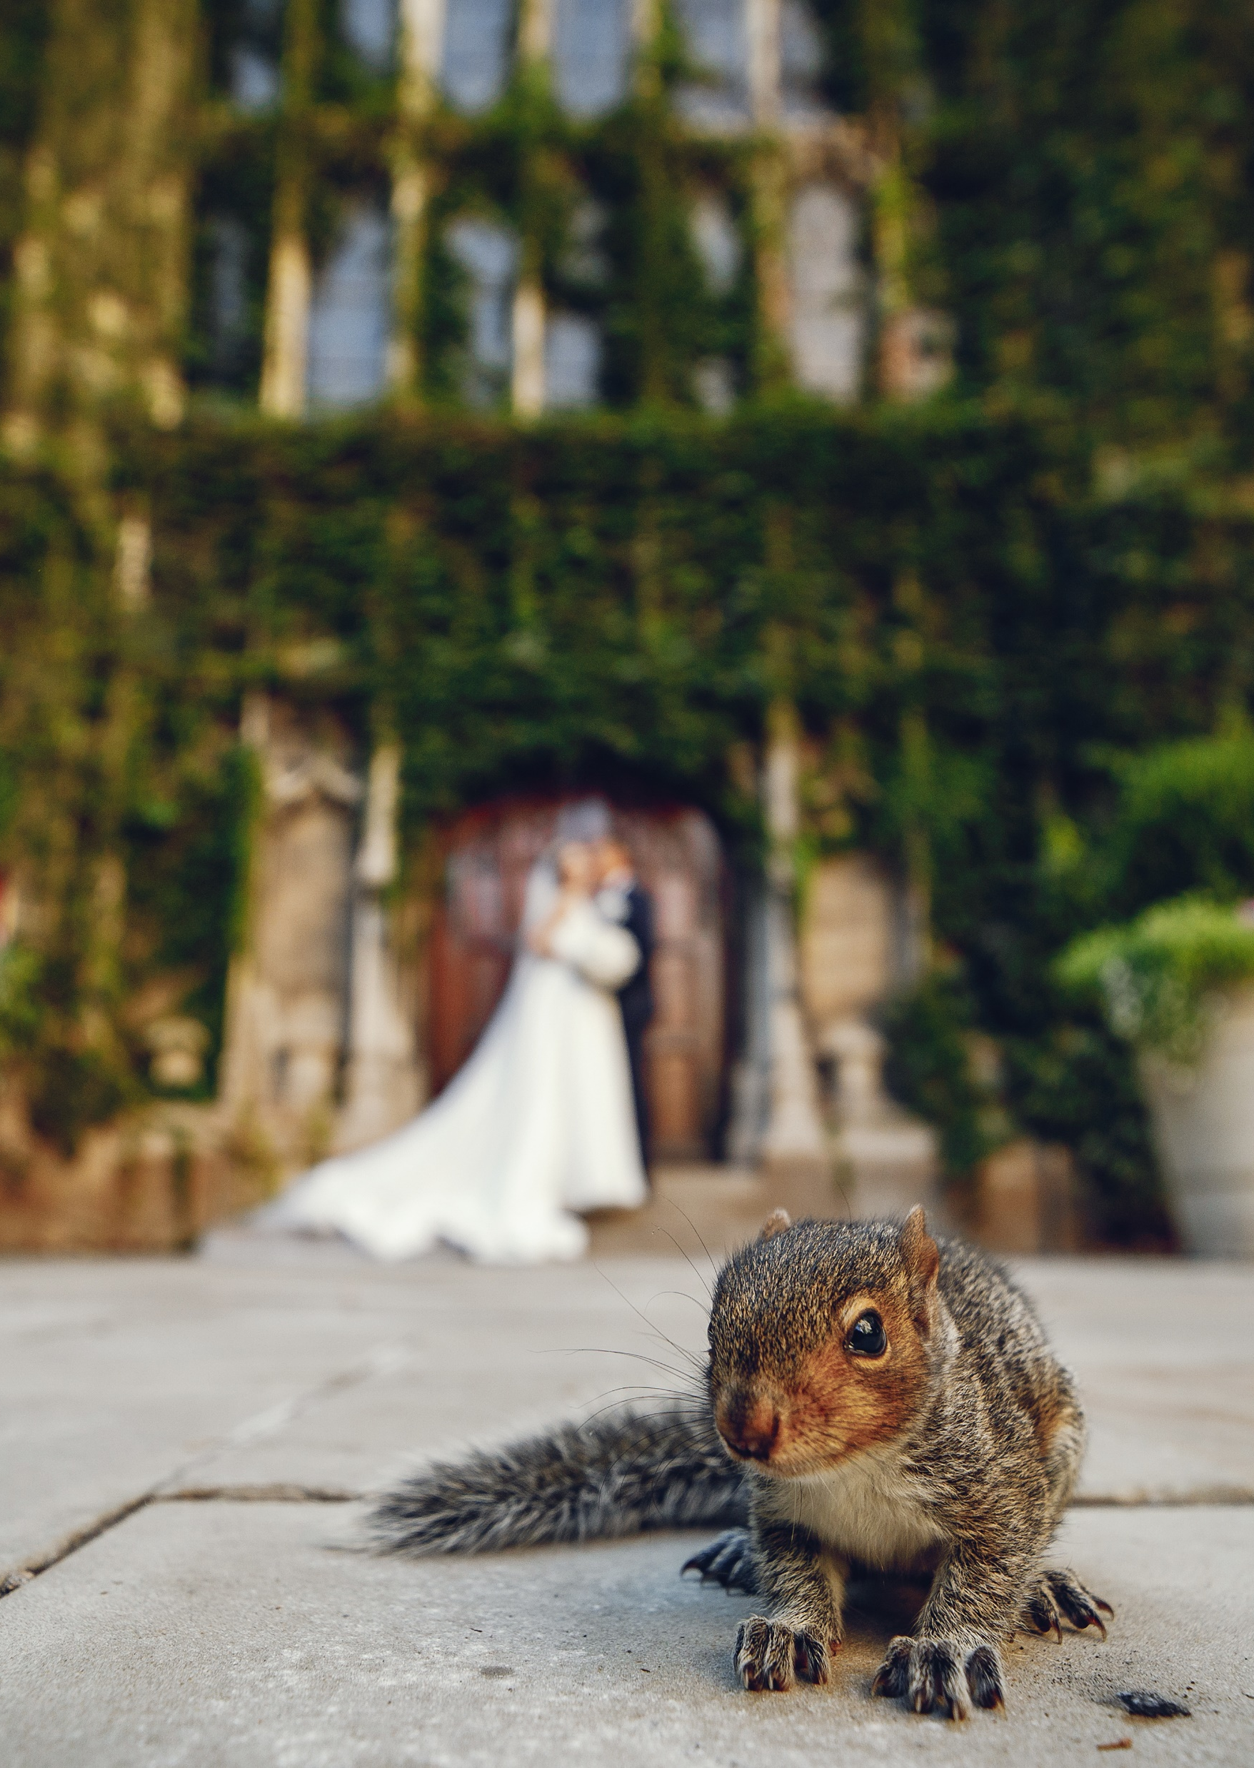

18
Amy Edmondson’s
‘Four Interpersonal Risks’
If you ask a question you could be viewed as ignorant
If you make a mistake you might be seen as incompetent
If you question ‘the way we do things’ it could be seen as being negative
If you ask for or provide feedback could be considered intrusive
‘No one wants to be the skunk at the picnic’

Slide 6
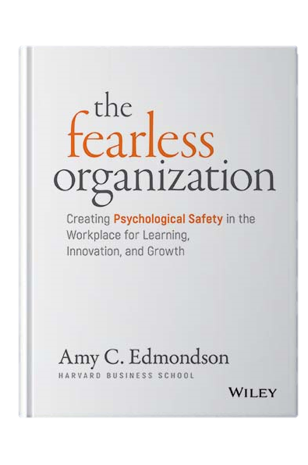
What is Psychological Safety?
A belief members of a team hold that it is safe for interpersonal risk taking
A sense of confidence that speaking up will not result in rejection, punishment or embarrassment by members of the team
A team environment of respect and interpersonal trust where people feel comfortable being themselves

Slide 7

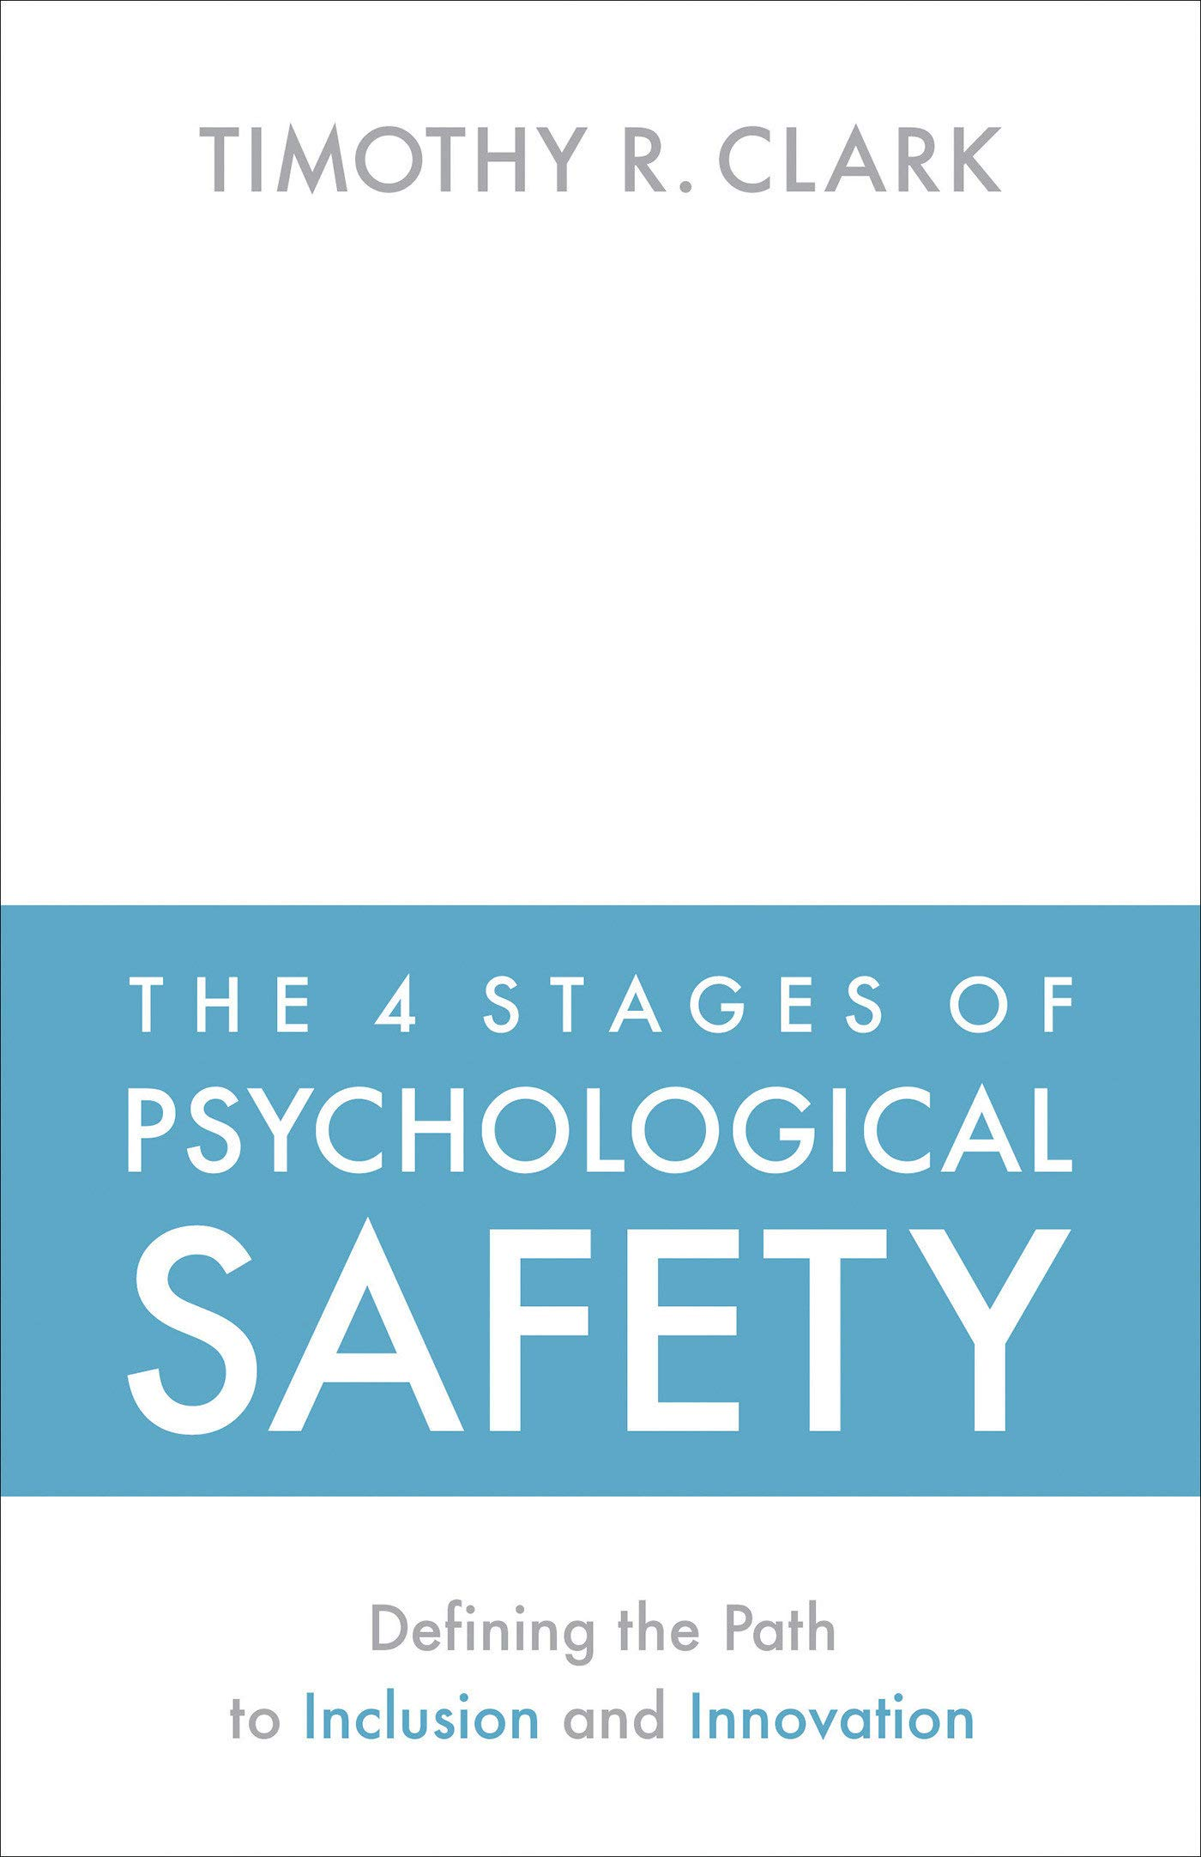
20
At its core,
Psychological Safety is…
“…the sense that you can be yourself without social, political, economical, or emotional cost”

Slide 8

Whose job is it?
Psychological Safety is all our responsibility”

Slide 9

Do You Make People Feel Safe?

Slide 10
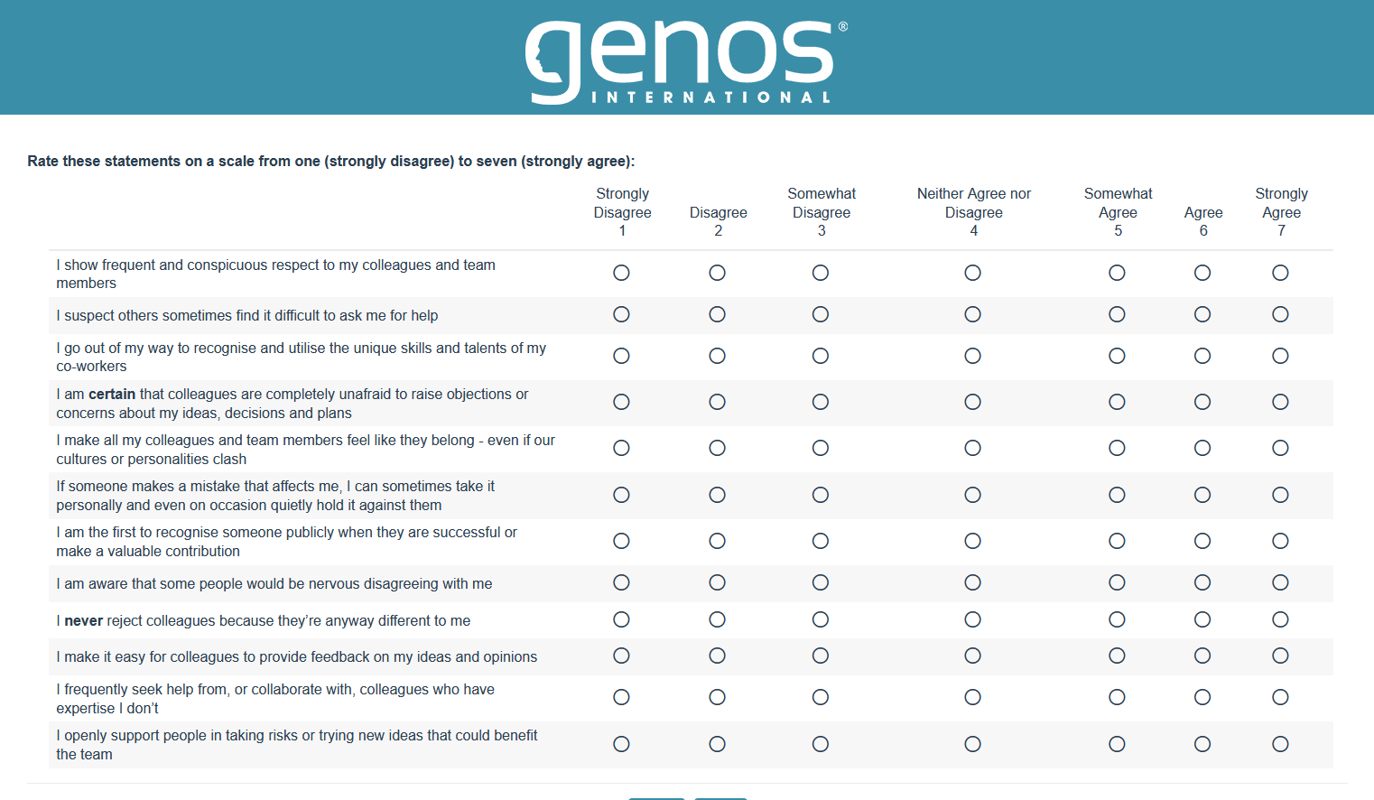

Slide 11
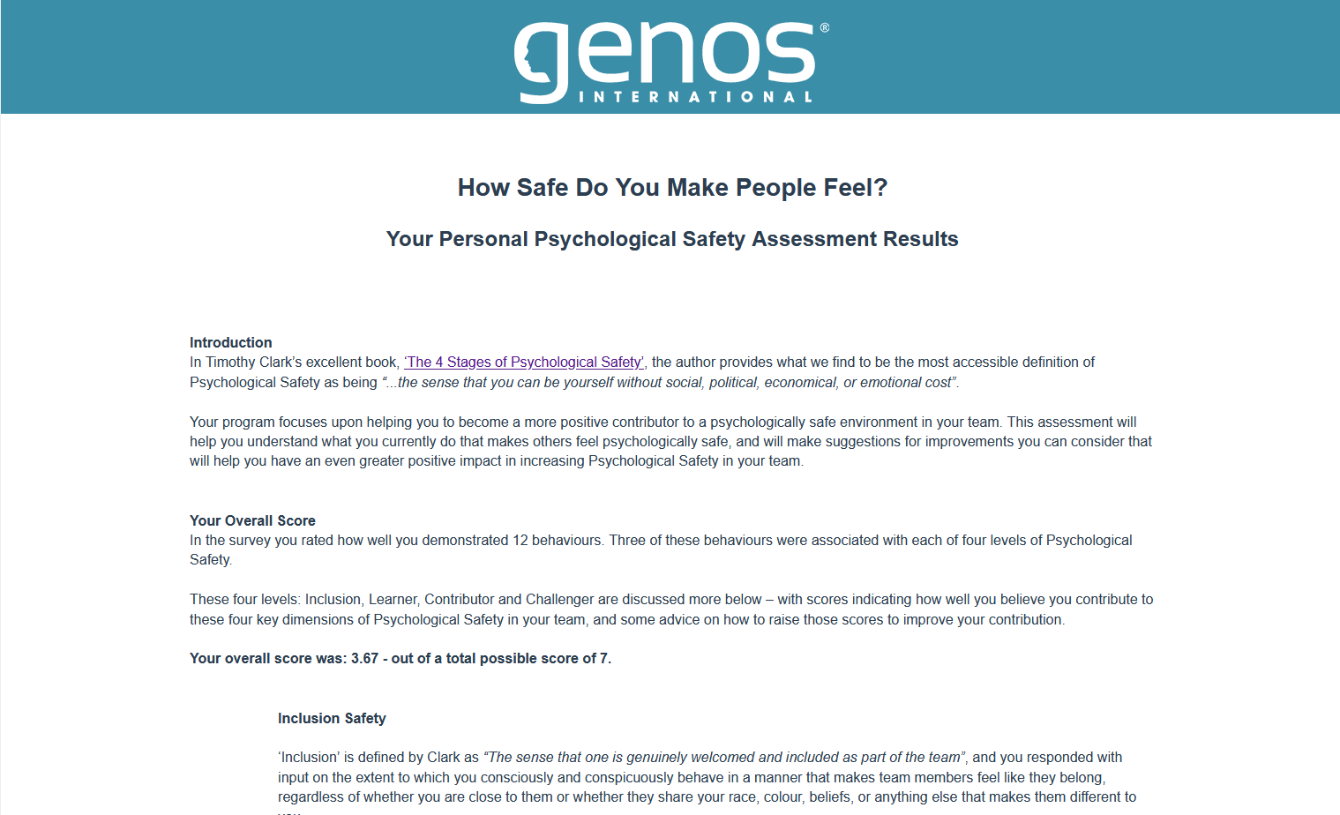

Slide 12

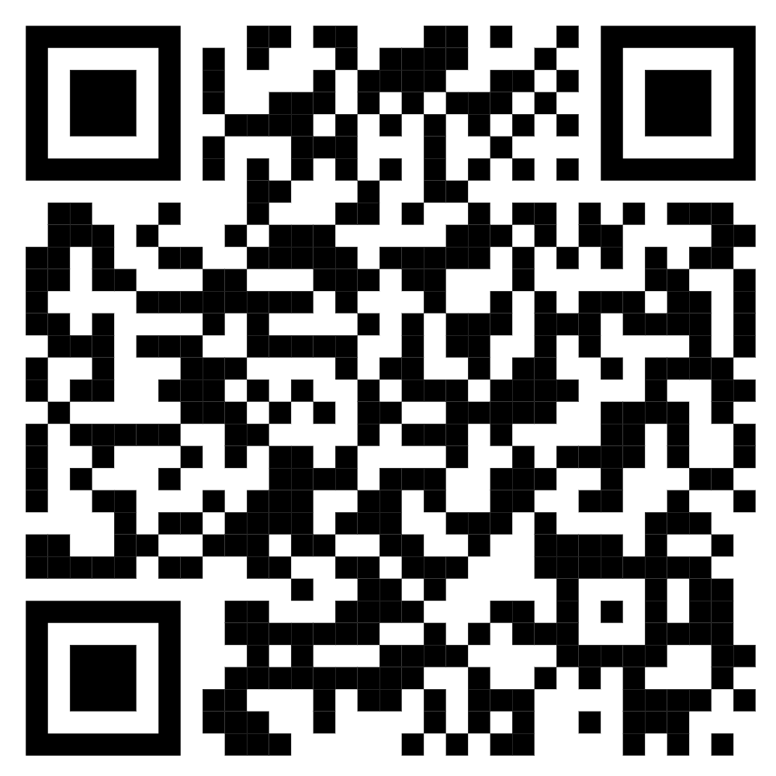
21
https://qr.me-qr.com/l/psych-safe

Slide 13

Taking Action 1
Review your results, and reflect
Identify one thing you’ll commit to personally to create more psychological safety around you
Consider one thing the team could do that would make it more psychologically safe for all
5 Mins

Slide 14

Top 10 Tips for cultivating Psychological Safety

Slide 15
10
Tips
Top 10 Tips for Cultivating
Psychological Safety

Slide 16
Tips
1
Educate your team on Psychological Safety and its key role in your team’s success

Slide 17
Share an explicit intent with the team to eliminate fear and create psychological safety for all
Tips
2

Slide 18
Involve everyone in discussions & decisions – draw out input & opinions from non-contributors
Tips
3

Slide 19
Continually ask team members for help in front of the team at large – recognise their expertise
Tips
4

Slide 20
Celebrate wins.
Learn from losses:
“…what will we do differently next time?”
Tips
5

Slide 21
Ask yourself continually:
“…Is it easy to raise concerns about my ideas, decisions and plans?”
Model that openness
Tips
6

Slide 22
Tips
7
When you screw up, do it in front of the team.
Be vulnerable

Slide 23
Tips
8
When they screw up, ask ‘what did we learn from that for next time?’

Slide 24
Be a ‘Don’t Know-er’:
“…I really have no idea – does anyone else know anything about this?”
Tips
9

Slide 25
Police the very human rush to judgement
- close it down in yourself and others
Tips
10

Slide 26
Let’s Build a Psychologically Safe Team – Together!

