Slide 1



  Why Emotional Intelligence?

Slide 2
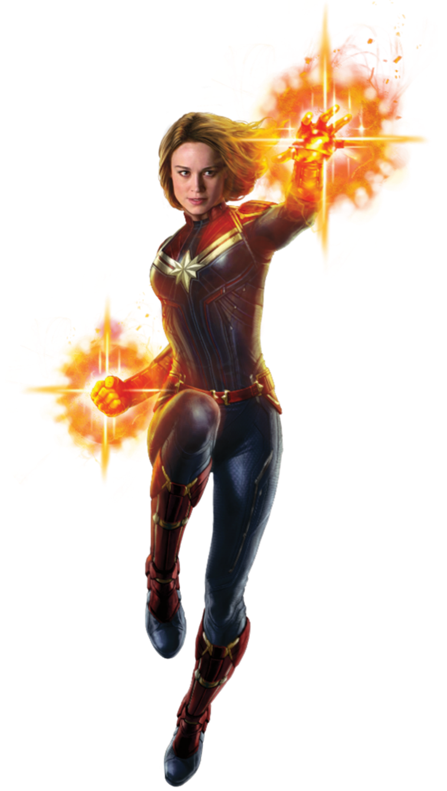
Think of the
Best Boss
you ever worked for
Write their name or initials on top of your page.

Slide 3
Your experience of your
Best Ever Boss
Demonstrates awareness of their mood and emotions
Makes other feel appreciated
Is open and honest about mistakes
Makes ethical decisions
Manages their emotions effectively in difficult situations
Recognises others’ hard work and achievements
Now, total those scores
Significantly less than others
Less than others
About Typical
More than others
Significantly more than others

Slide 4

How did you feel
around this person?
Write down three words

Slide 5
How well did your
Best Ever Boss
engage you?
1 2 3 4 5 6 7 8 9 10
Utterly
Disengaged
‘So-so’
Highly
Engaged

Slide 6
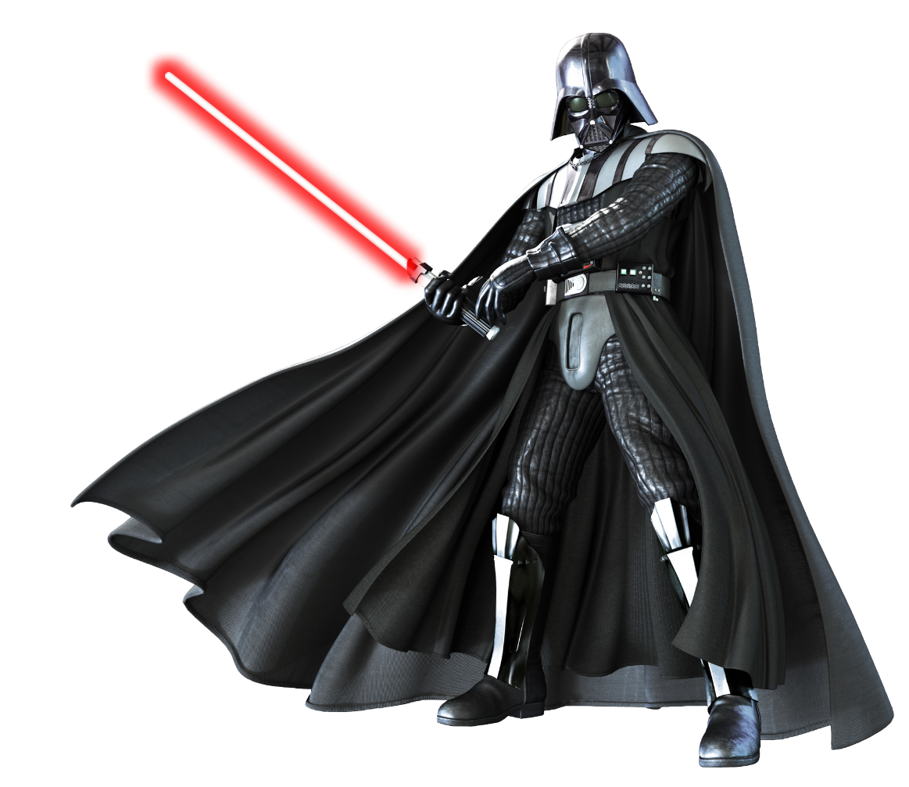
Think of the
Worst Boss
you ever worked for
Write their name or initials on top of your page.

Slide 7
Your experience of your
Worst Ever Boss
Demonstrates awareness of their mood and emotions
Makes other feel appreciated
Is open and honest about mistakes
Makes ethical decisions
Manages their emotions effectively in difficult situations
Recognises others’ hard work and achievements
Now, total those scores
Significantly less than others
Less than others
About Typical
More than others
Significantly more than others

Slide 8
How did you feel
around this person?
Write down three words

Slide 9
How well did your
Worst Ever Boss
engage you?
1 2 3 4 5 6 7 8 9 10
Utterly
Disengaged
‘So-so’
Highly
Engaged

Slide 10
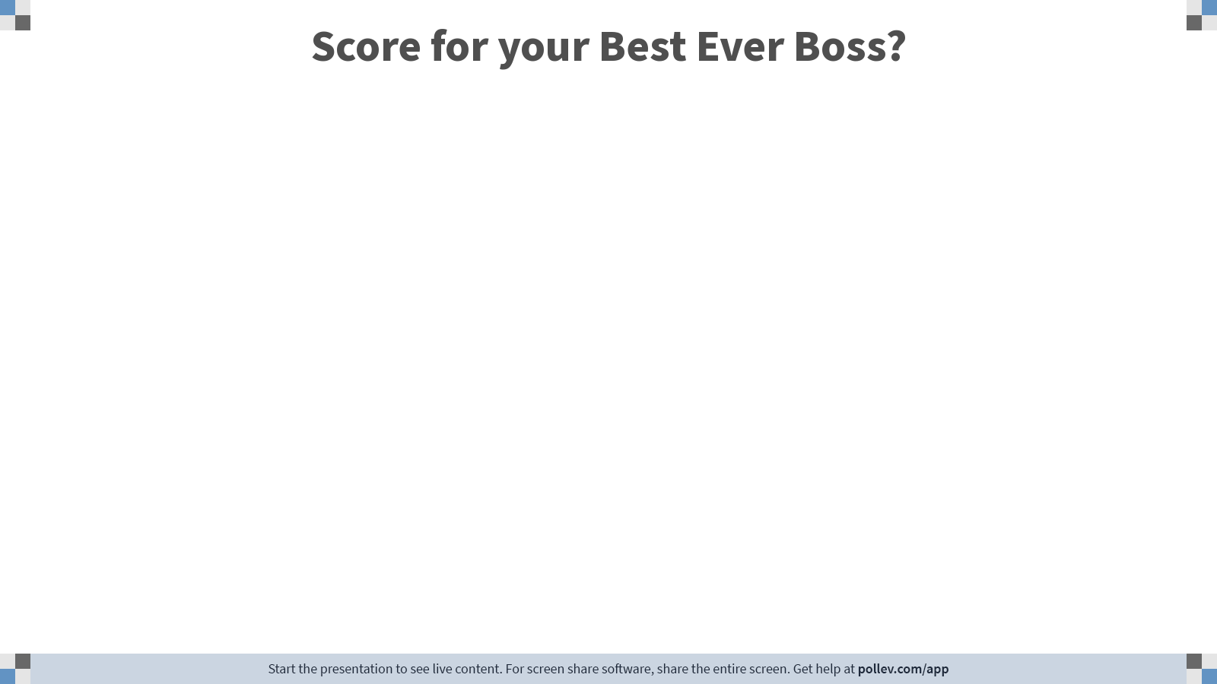
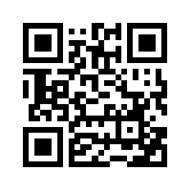
pollev.com/deiricm000
Notes:
Poll Title: Do not modify the notes in this section to avoid tampering with the Poll Everywhere activity.
More info at polleverywhere.com/support
Score for the person who put you at ease?
https://www.polleverywhere.com/free_text_polls/2EXCsyXyP8rwciyHzsBqV

Slide 11

pollev.com/deiricm000
Notes:
Poll Title: Do not modify the notes in this section to avoid tampering with the Poll Everywhere activity.
More info at polleverywhere.com/support
Score for the person who made you feel fearful?
https://www.polleverywhere.com/free_text_polls/hgj9CdBO9OgQLwVUmO9IC

Slide 12
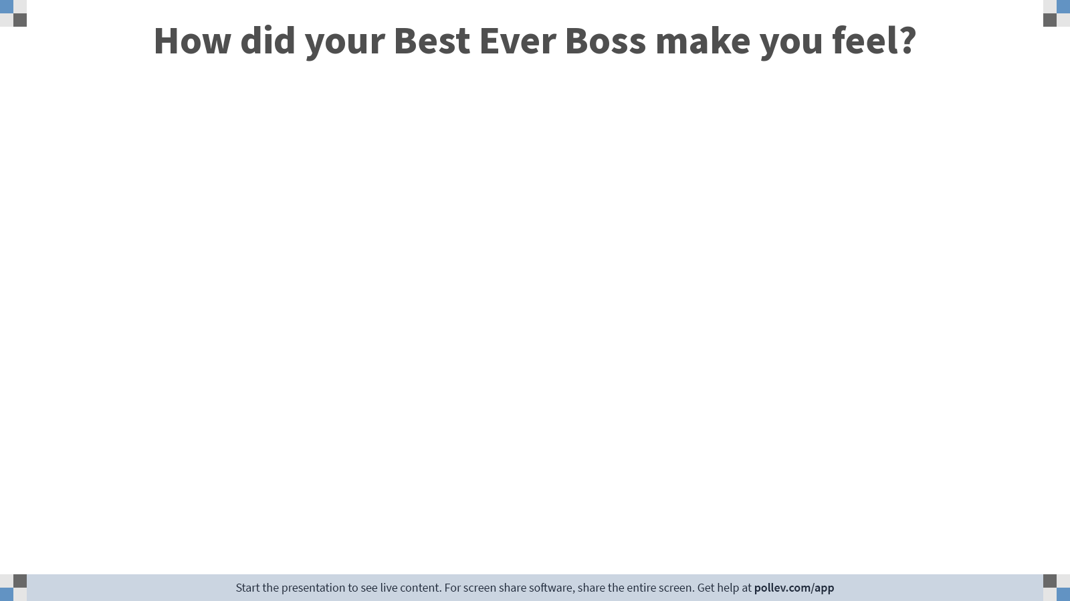
pollev.com/deiricm000
Notes:
Poll Title: Do not modify the notes in this section to avoid tampering with the Poll Everywhere activity.
More info at polleverywhere.com/support
How did the 'at ease' person make you feel?
https://www.polleverywhere.com/free_text_polls/ClYqC6smETNAlOPbEUG4w

Slide 13

pollev.com/deiricm000
Notes:
Poll Title: Do not modify the notes in this section to avoid tampering with the Poll Everywhere activity.
More info at polleverywhere.com/support
How did the 'fearful' person make you feel?
https://www.polleverywhere.com/free_text_polls/Z6jCRt3s1OK6FbEcUSq7r

Slide 14
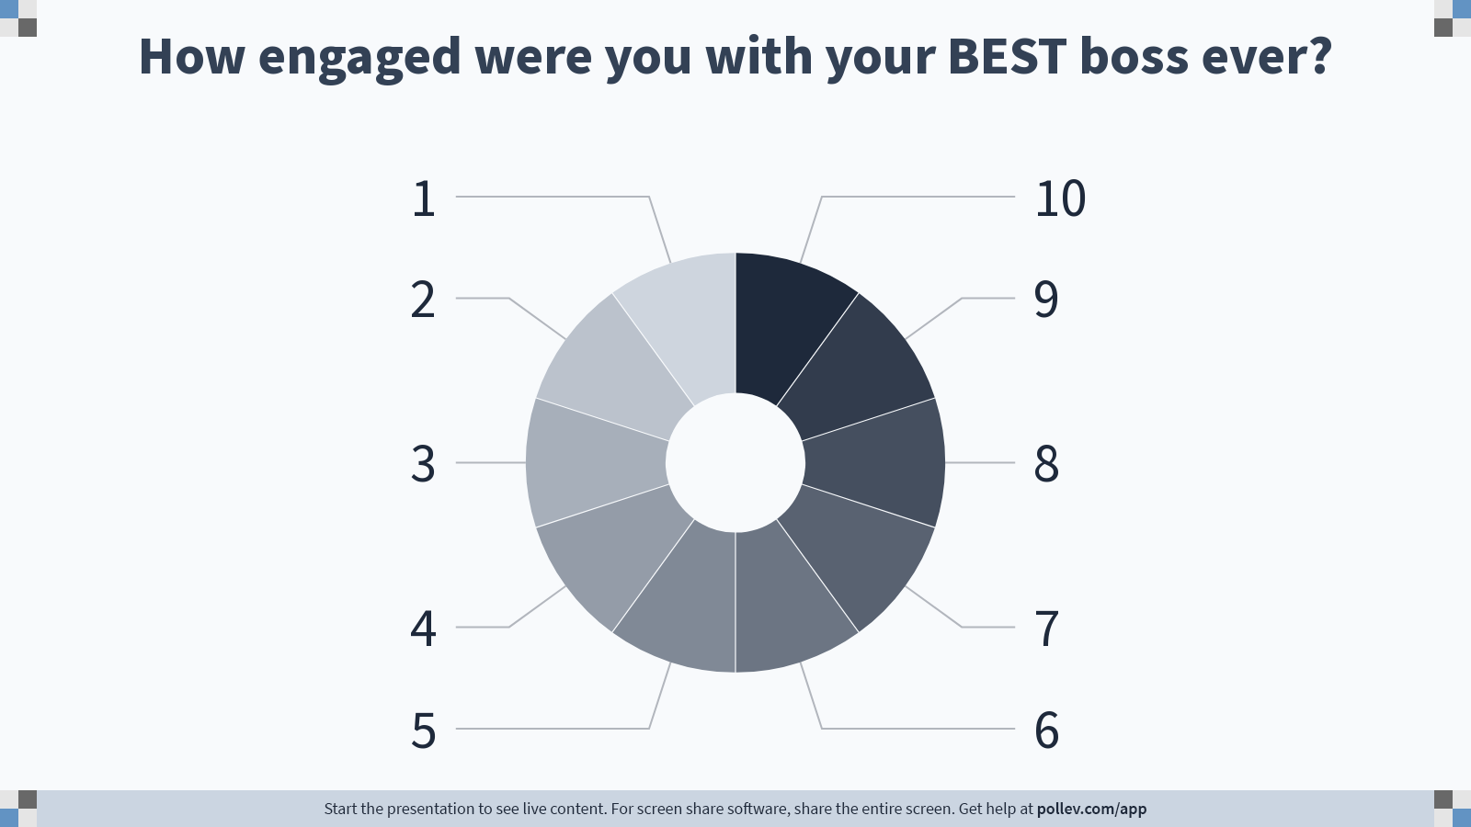
Notes:
Poll Title: Do not modify the notes in this section to avoid tampering with the Poll Everywhere activity.
More info at polleverywhere.com/support
How engaged were you with your BEST boss ever?
https://www.polleverywhere.com/multiple_choice_polls/ywOKyWVrzbx6mqBSMNsdG?display_state=chart&activity_state=opened&state=opened&flow=Default&onscreen=persist

Slide 15
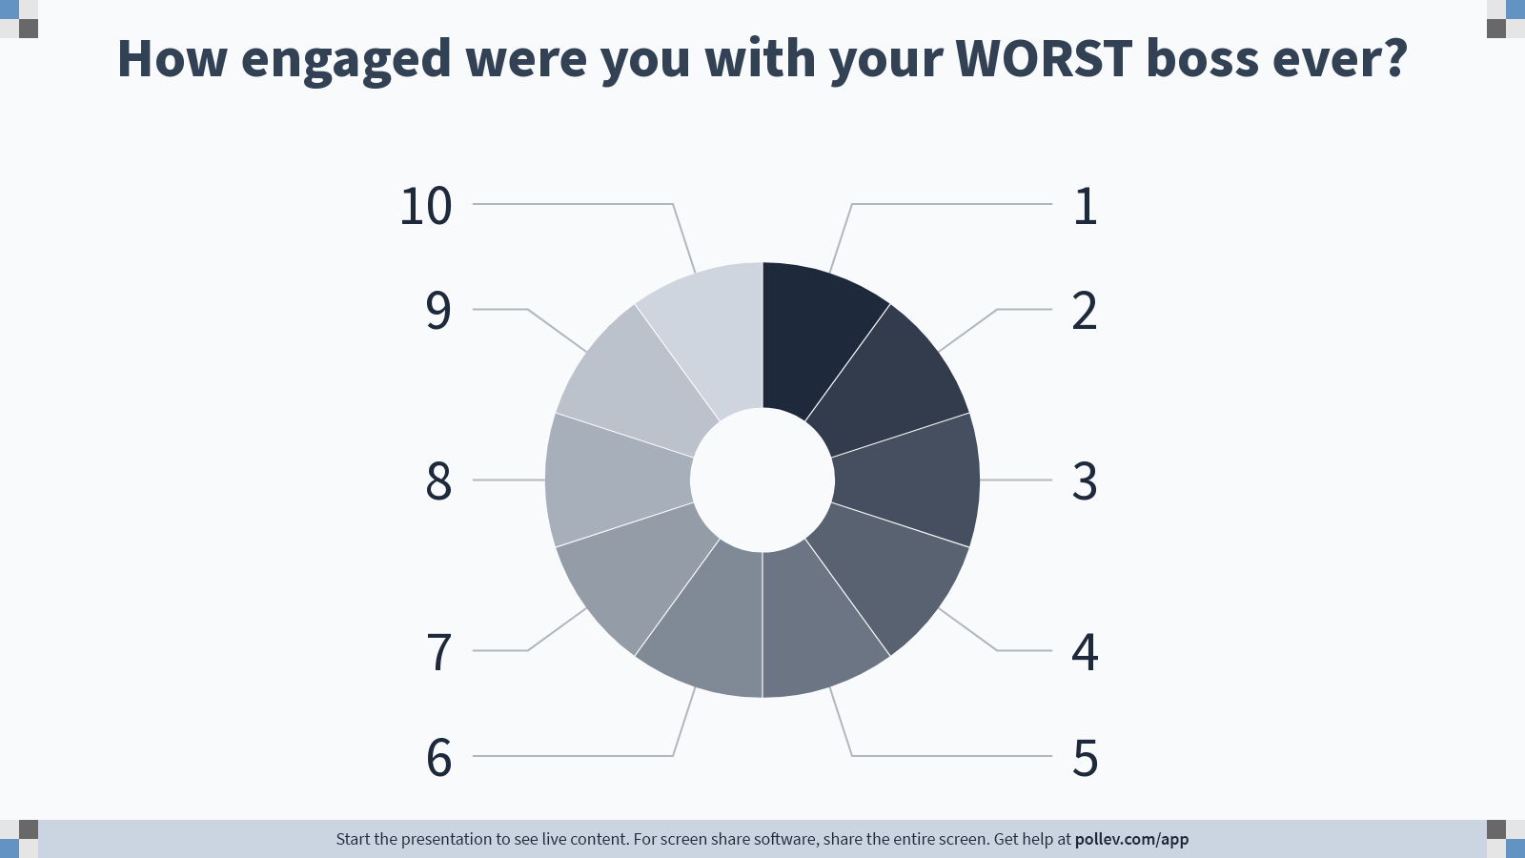
Notes:
Poll Title: Do not modify the notes in this section to avoid tampering with the Poll Everywhere activity.
More info at polleverywhere.com/support
How engaged were you with your WORST boss ever?
https://www.polleverywhere.com/multiple_choice_polls/EntC6P4Ym6N5S2QYvEdwO?display_state=chart&activity_state=opened&state=opened&flow=Default&onscreen=persist

Slide 16
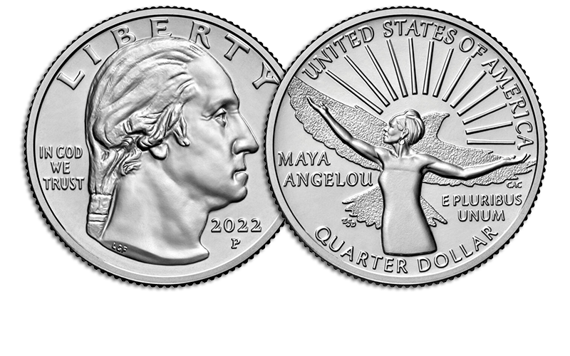
“People will forget what you said,
People will forget what you did,
But people will never forget
how you made them feel”
Maya Angelou

Slide 17
Why it matters…
The way you ‘show up’…
…determines the way people feel,
and the way they feel…
…determines the extent to which they can engage…
…and that impacts pretty much EVERYTHING
about the outcome of that relationship…

Slide 18
Before You Meet…1
“How do I want this person to feel when we finish our meeting?”
‘Begin with the end in mind’

Slide 19
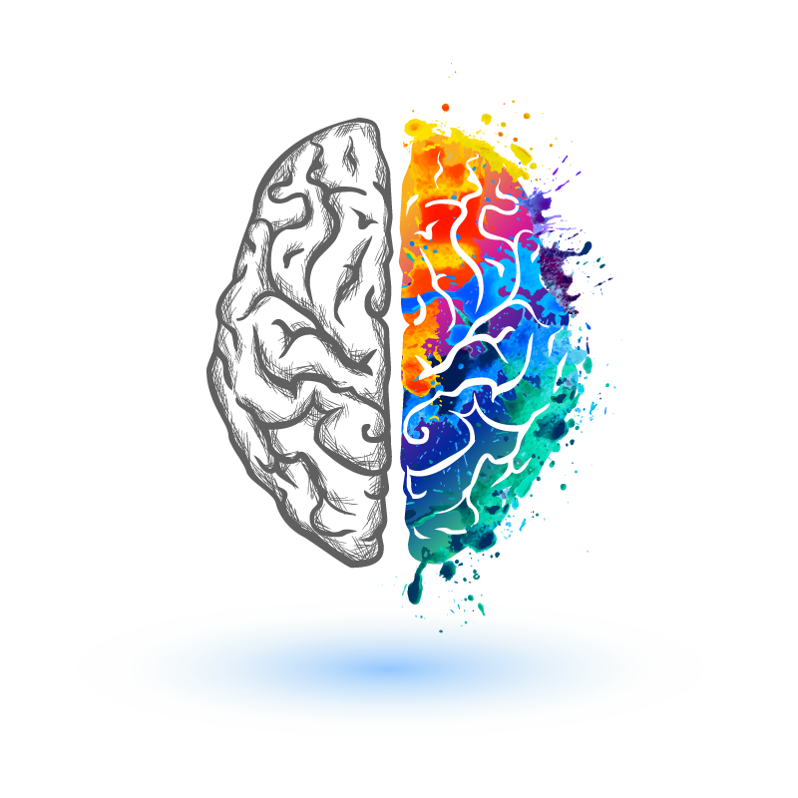
The Neuroscience
of Emotional Intelligence

Slide 20
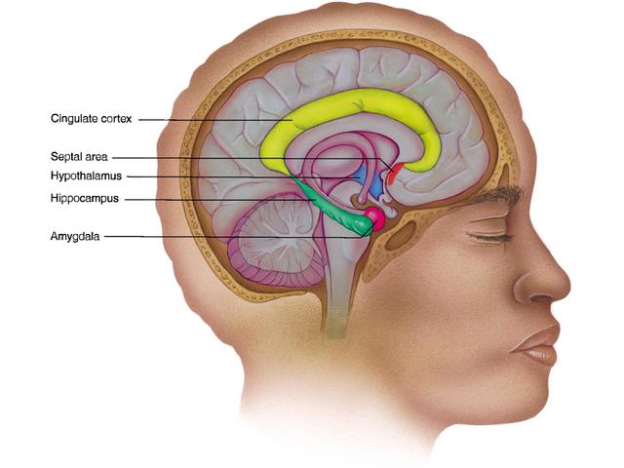
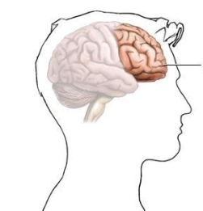
Emotional Brain
Reward
Decisions
Do I trust this person?
Can I let my guard down?
Will I engage?
Am I safe opening up?
Do I want to be here?
Stimulus
Thinking Brain
Danger/ Threat

Slide 21
“Everything you do in life is based upon your brain’s determination to minimise danger or maximise rewards.
Minimise threats and maximise rewards
is the organising principle of the brain”
(Gordon, 2000)

Slide 22
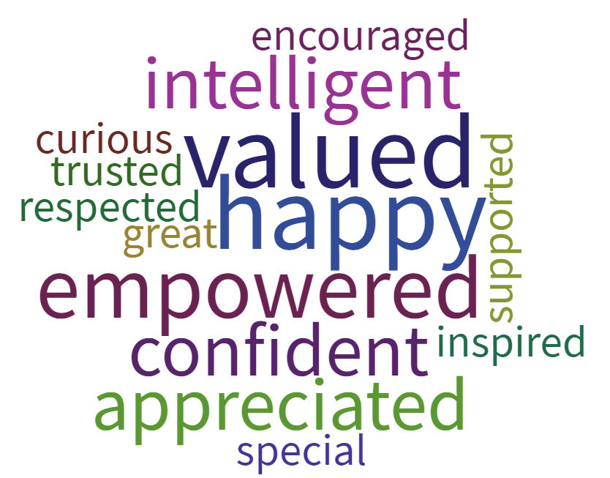
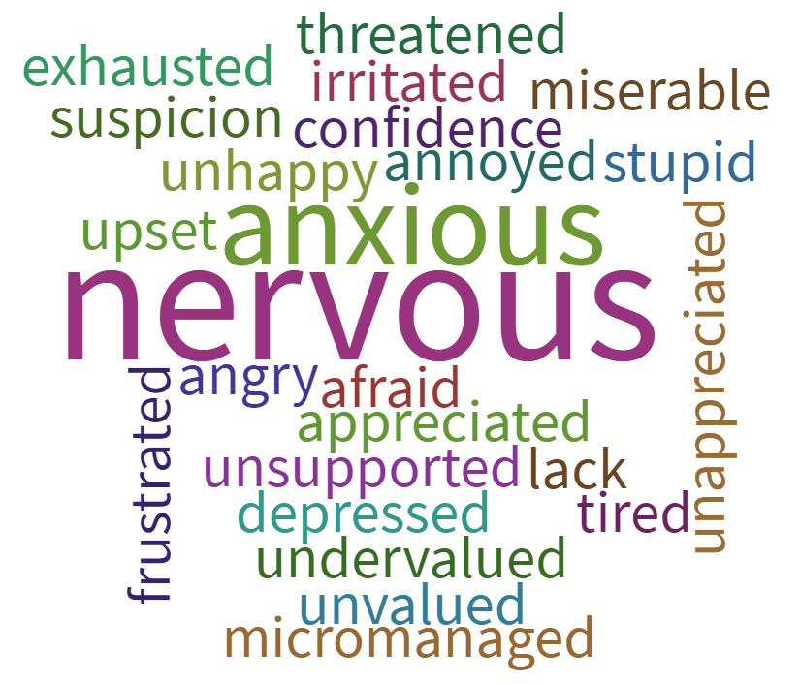
Fear free
‘Broaden & Build’
Creativity enhanced
Move towards (Stay / Engage)
Emotional Brain
Reward
Decisions
Do I trust this person?
Can I let my guard down?
Will I engage?
Am I safe opening up?
Do I want to be here?
Stimulus
Thinking Brain
Danger/ Threat
Fearful
Managing risk - CYA
Self-censorship
Creativity impaired
Run away! (Leave / Disengage)

Slide 23
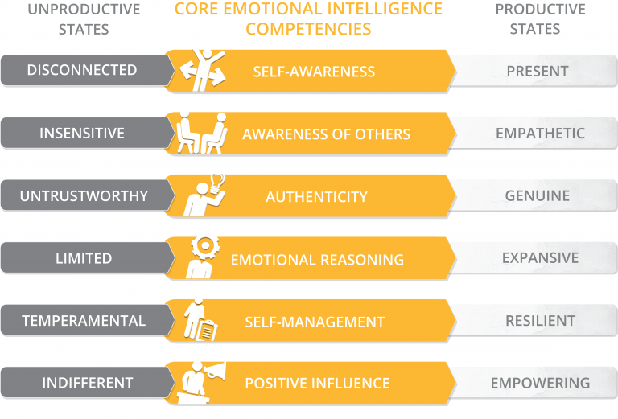
You assessed their
‘Demonstrated
Emotional Intelligence’
“Demonstrates awareness of their moods & emotions”
“Makes others feel appreciated”
“Is open and honest about mistakes”
“Makes ethical decisions”
“Manages their emotions effectively in difficult situations”
“Recognises other’s hard work and achievements”

